Slide 1

Face Mask Detection
By- Bhavya Mittal
Domain- Machine Learning
Roll No.- 2200270100058

Slide 2

Problem Statement
Create a machine learning model to detect the presence of face masks in images or live video feeds. This system aims to assist in enforcing mask-wearing regulations in public spaces, contributing to efforts to mitigate the spread of contagious diseases.

Slide 3
Requirements
Knowledge of Deep Learning Concepts
Transfer Learning-Mobile Net
Open CV
Haar Cascades

Slide 4
Deep learning
Deep Learning is a subfield of Machine Learning that involves the use of neural networks to model and solve complex problems.
Deep Learning algorithms can automatically learn and improve from data without the need for manual feature engineering.
Deep Learning has achieved significant success in various fields, including image recognition, natural language processing, speech recognition, and recommendation systems.

Slide 5
Transfer Learning- Mobile Net
Transfer learning is the reuse of a pre-trained model on a new problem. In transfer learning, a machine exploits the knowledge gained from a previous task to improve generalization about another.
MobileNet is a computer vision model open-sourced by Google and designed for training classifiers.
It uses depthwise convolutions to significantly reduce the number of parameters compared to other networks, resulting in a lightweight deep neural network. MobileNet is Tensorflow’s first mobile computer vision model.

Slide 6
Open CV
OpenCV (Open Source Computer Vision Library) is an open-source computer vision and machine learning software library.
OpenCV is a powerful library that provides a wide range of functionalities for tasks such as image and video processing, object detection and tracking, feature extraction, camera calibration, and more.
It is written in C++ and has interfaces for C++, Python, Java, and MATLAB, making it accessible to developers working in different programming languages.

Slide 7
Haar Cascades
A Haar-like feature considers adjacent rectangular regions at specific location in a detection window, sums up the pixel intensities in each region and calculated difference between these sums.
This difference is then used to categorize subsections of image
Haar Cascade combines multiple Haar features in a hierarchy to build a classifier.
Cascade breakdown the detection process into stages, each consisting of a set of features.

Slide 8
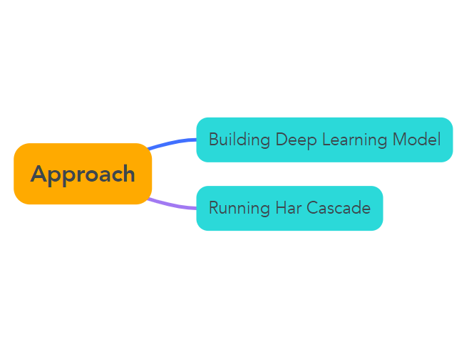

Slide 9
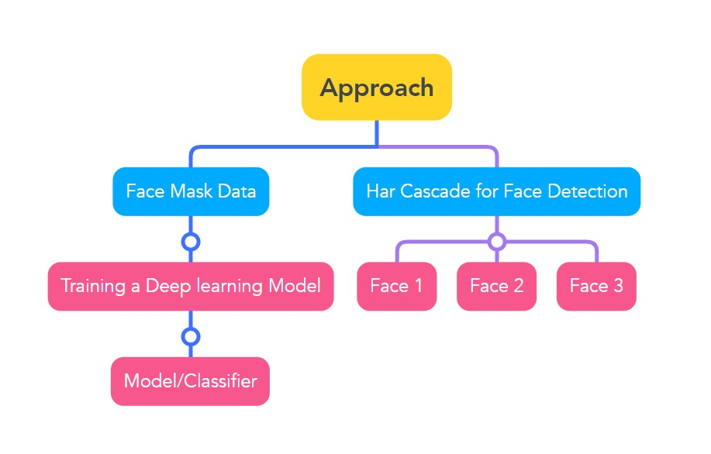

Slide 10
Platforms Used
Kaggle
Google Collab
Jupyter Notebook using Anaconda Environment

Slide 11
Thank You!!

